Slide 1
Data Analytics

Slide 2
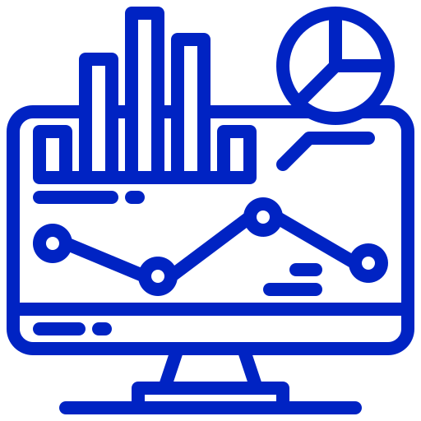
Infomineo has a unique approach to Data Analytics
Analytics
Traditional model
Infomineo model
Most Data analytics companies provide standard models that they transpose from a client to another
Often Data analytics companies provides models that stay in the state of Proof-Of-Concept because integration with IT teams is not complete
Most Data analytics providers are specialized in Visualization tools : Tableau, Power Bi etc.
Most providers work on a project basis – The models are afterwards difficult to maintain over time by the clients' teams
The providers retain rights on the Intellectual property they generate
We are problem solvers, we need to understand your question or challenge and will find the data & models which answers your question
We have a multi capabilities team that can provide you an end-to-end approach from cleaning the data to visualizing the model output
We work on a retainer basis, we are an extension of your team, and make it easy to work with us, which 1/minimizes the time you spend on paperwork and 2/allows you to work with us on an iterative basis
The output is co-constructed with our client and not a model taken off the shelf

Slide 3
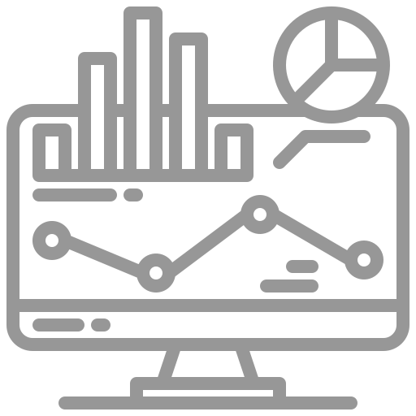
Infomineo offers a full suite of Data Analytics Services
Analytics
Three Levels of Analytics
Business Oriented Approach
Three Types of Support
Data Exploration & Cleaning
Data Visualization : reports, automated dashboards
Gathering Data from various storage, Assessing Data Quality and processing cleaning and wrangling
Data Analysis
Infomineo’s teams demonstrate a high Business sense
We work in an iterative approach to fulfill clients needs quickly
Data Preparation
Statistical Analysis
Model building & tuning
Model evaluation & retraining
Business & Data Understanding
Agile Methodology
Data
Science
Interactive Visualization
Building and maintaining self service analytics
Delivery Management
Feature Engineering : Data wrangling, Data transformation
Model Deployment & scalability
Building predictive and prescriptive models & possibility to deploy to production
Data Engineering
Release & Change Management are handled: versioning, unit tests, model validation, code reviews, documentation…
Modeling

Slide 4



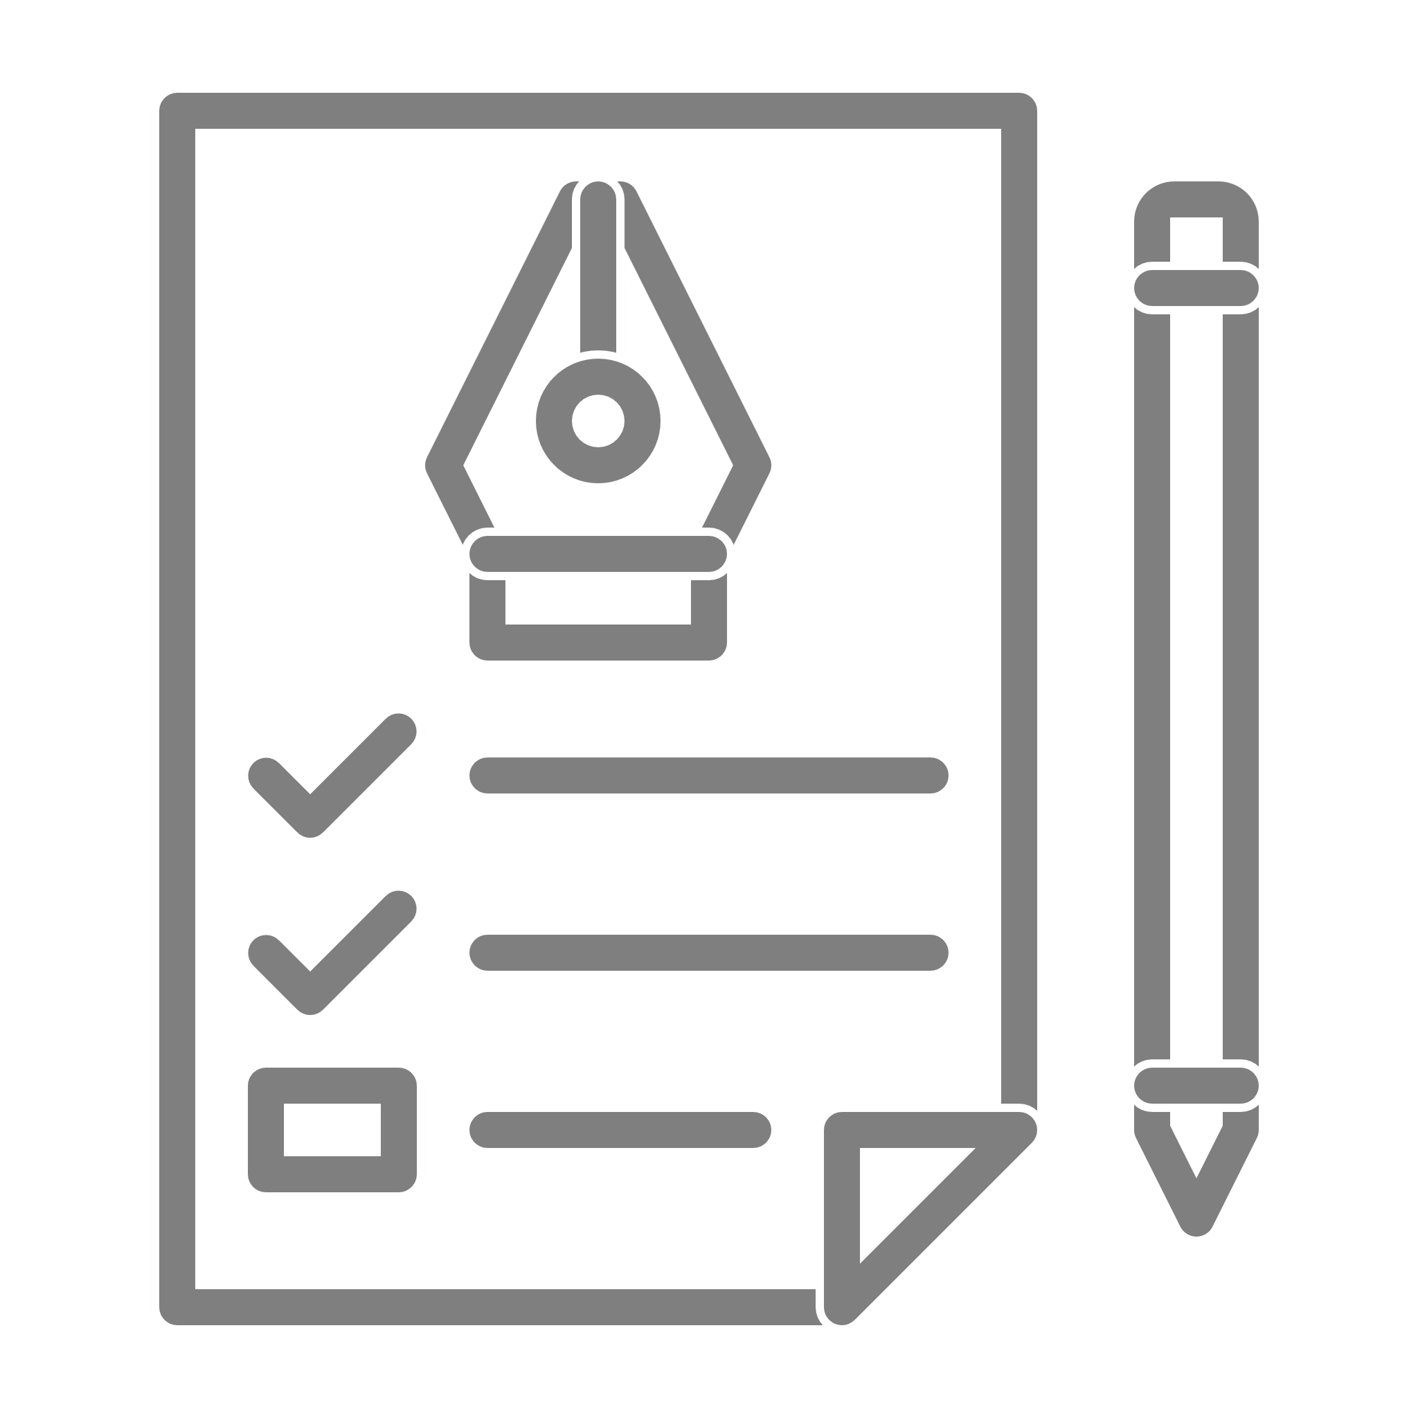
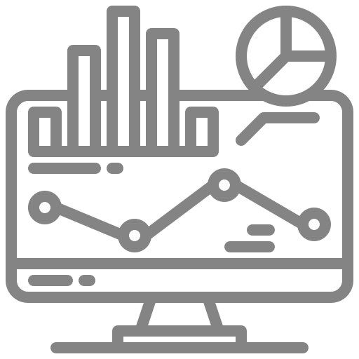


Our approach to helping you
Analytics
Intake
Execution
Delivery
Understanding client needs and objective
Get a deep understanding of the client objectives:
Type of analytics support considered
Business questions to answer
Assess available data, data needs if any, critical data elements to take care of
Planned use of the analytics outputs
Structuring approach
Define the best data analytics strategy to answer the client’s business objective
Estimate the time needed
Define the type of output needed
Executing Analytics
Leveraging a full range of analytics capabilities
Data Preparation
Identifying Data Sources
Extracting & Transferring Data
Metadata & Dictionaries
Merging of various data sources & adding new data
Assessing Data Quality
Handling Outliers
Restructuring Data for analysis
Making features extractions
Business & Data Under
standing
Agile Metho
dology
Data Modeling
Build algorithms to answer the business question (binary classification, segmentation, forecasting …)
Evaluation and validation of the algorithm
Deriving insights
Performing in-depth quality assurance
Analyzing the data outputs to derive insights in line with the initial client ask
Handover
Presenting the approach, results and potential limitations
Sharing all the documentation & codes
Getting client feedback
Definining scaling with clients’ IT Teams (to be scheduled if any)
Performing regular model maintenance (to be scheduled if any)
Delivery Management
Exploratory Analysis
Descriptive analysis
Data visualization
KPIs
Data story telling

Slide 5
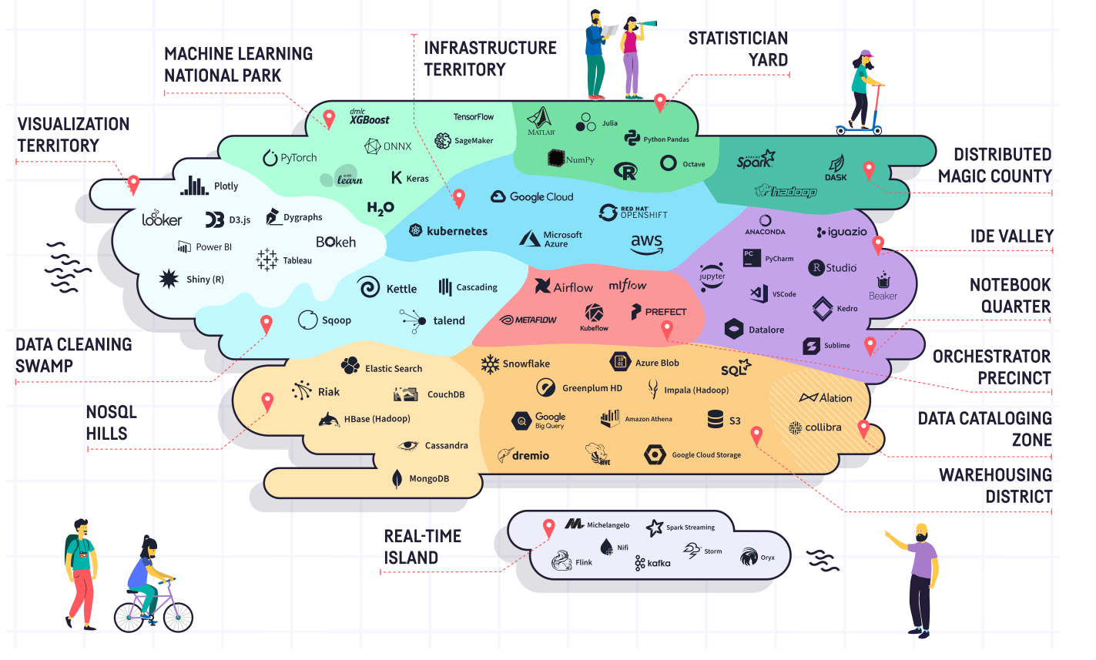

Technologies Infomineo can be handling
Capabilities we already have
Capabilities we are building

Slide 6
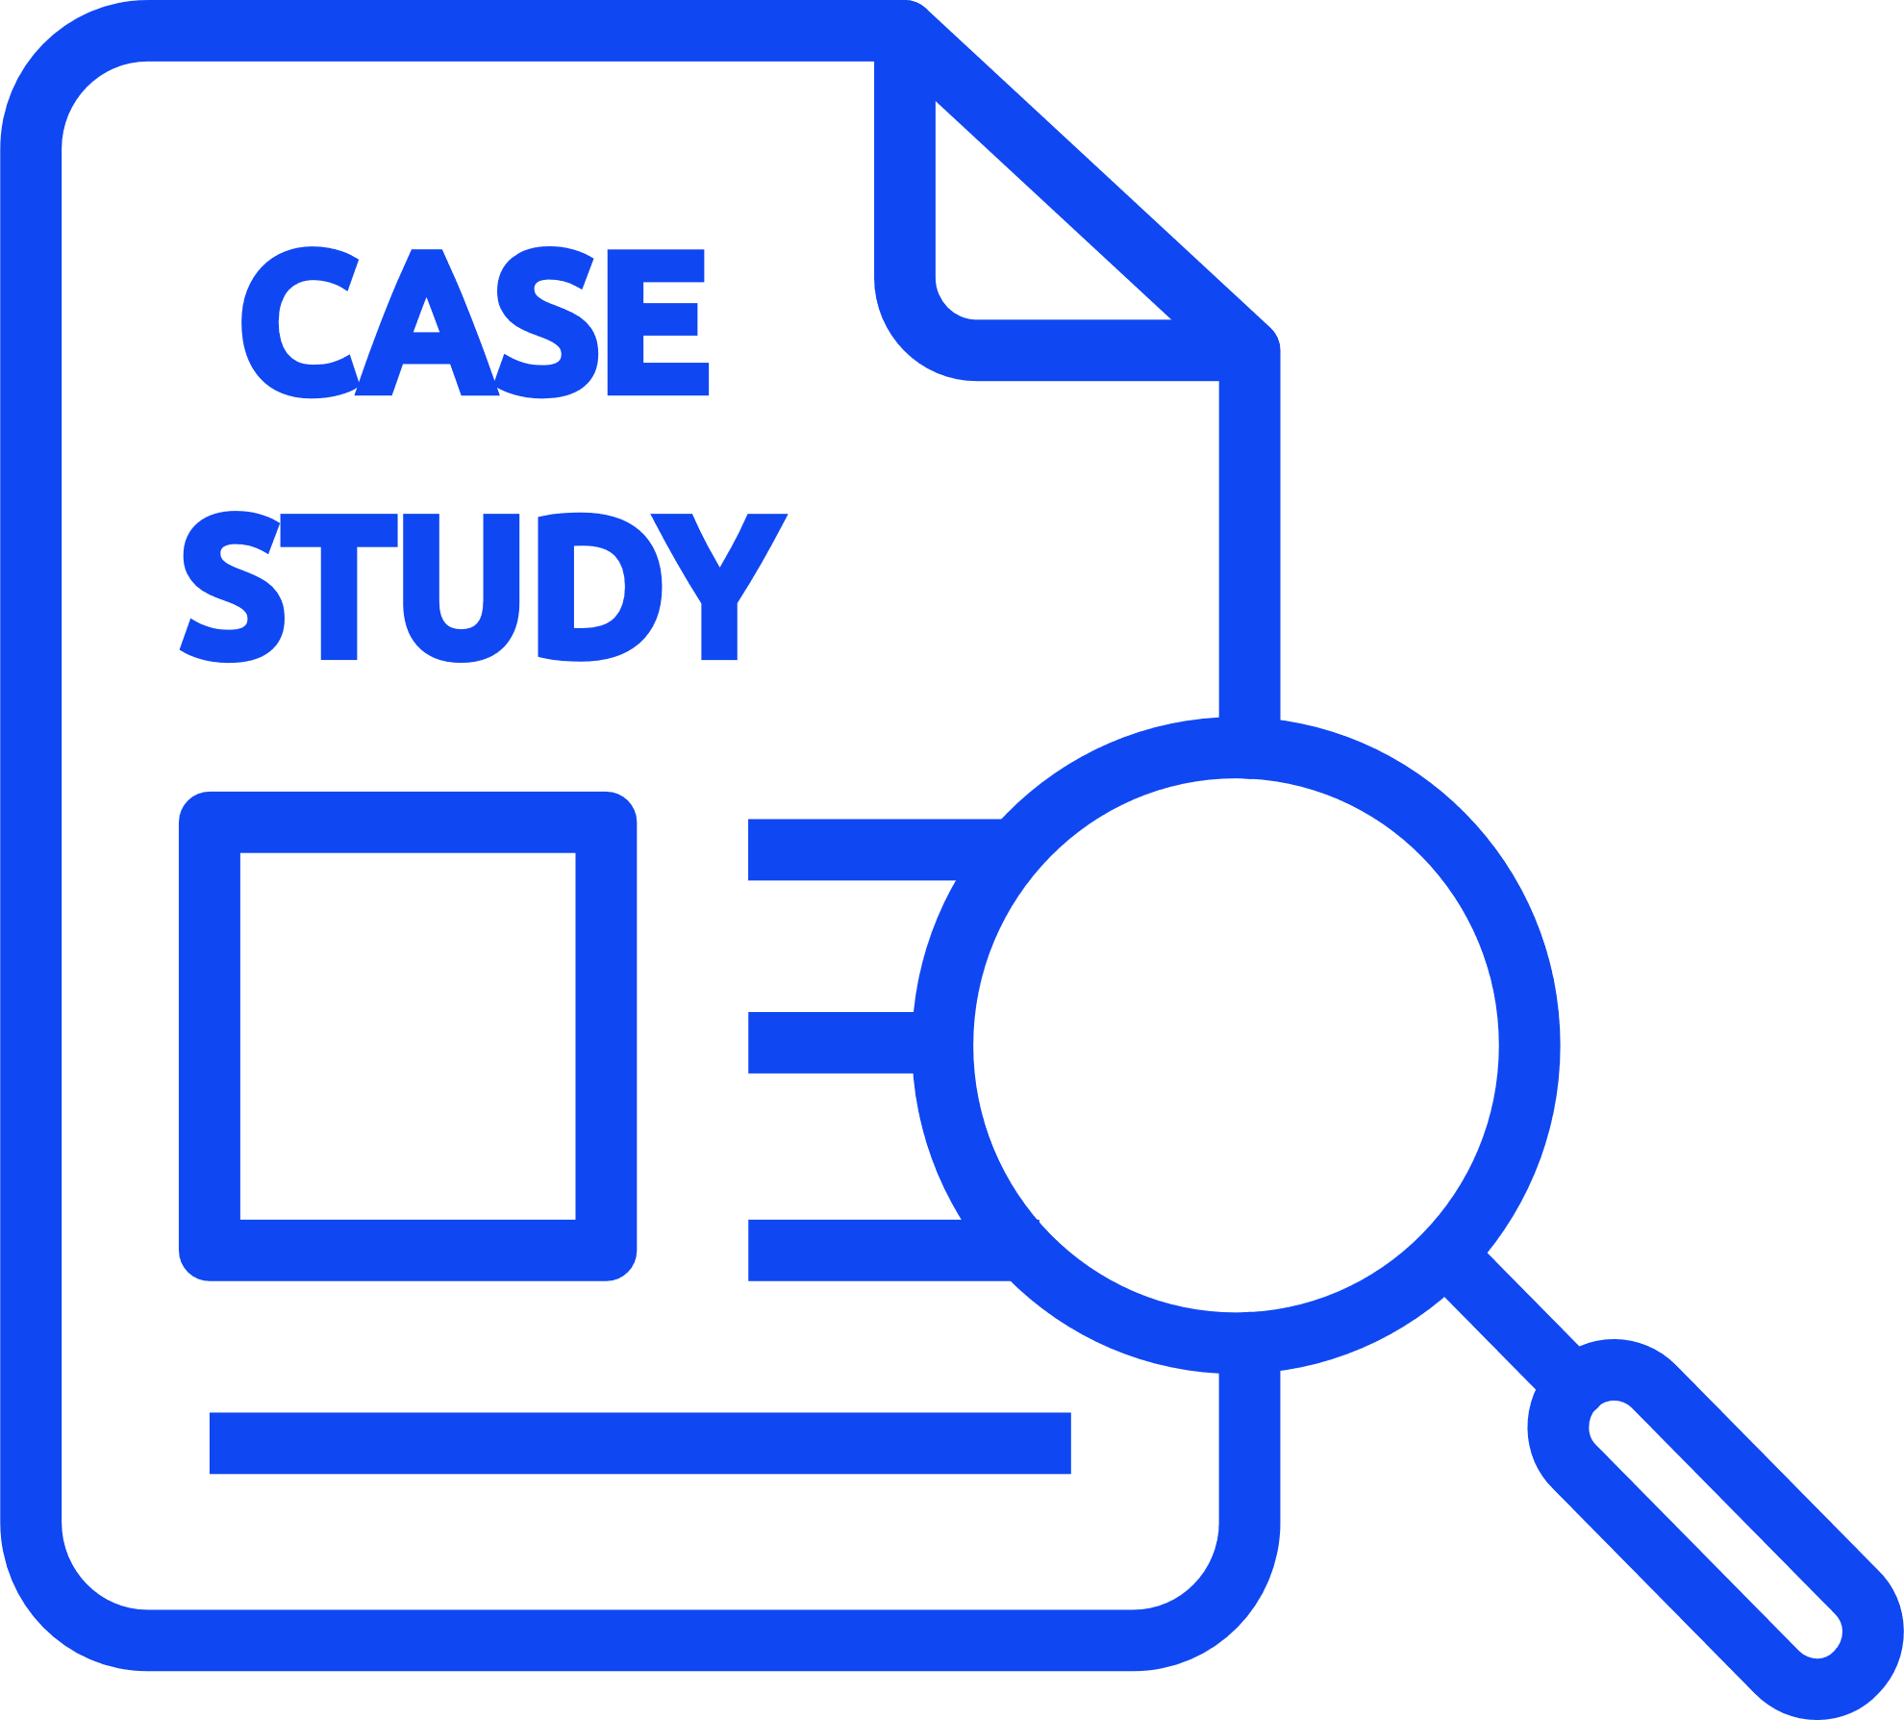


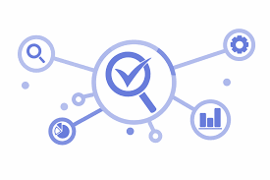

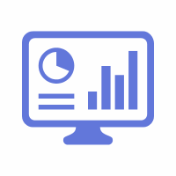



CASE STUDY
Client Challenge
Our Solution
Outcome
Client:
The client wants to have an automatized Human Resource Dashboard to track, analyze and report on HR KPIs.
The firm was looking for:
The company decided to use Infomineo’s Data Analytics service as a solution to cover:
The firm recognized that the quality of the Data Analytics service provided a useful reporting tool resulting in:
A multinational firm
Data Quality & Consistency problems between the various Data sources
Dashboard creation that reflects HR Team needs
During the project, Data were corrected in the ERPs :
Manual files where not used anymore
Data Quality improved by 55% for critical data elements
Effective and quick solution
“I was really impressed by the responsiveness of the team : they came up with a first and quite impressive dashboard proposition within only a couple of days. I also really appreciated the quality of the work; it was really helpful for us to identify the data cleansing needed in our ERP.”
─ Chief Human Capital Officer (Client)
Estimated 1 FTE from the HR department could be reallocated to other tasks
Helped the company to start its Data Transformation
Infomineo has been asked to work with client’s Finance Team to create another dashboard
Smooth integration with its existing ERPs
Lower cost than buying from a specialized company an HR Dashboard tool
Ad-hoc deliverables :
Dictionaries, Creation of Metadata, Data Quality On boarding

Slide 7






Why work with us
Research
Combination of Data Analytics and Data Research methodologies
Opportunity to work with a unique professional network
Optimum confidentiality and integrity - ISO certified & RGPD Compliance
World class Data Analytics capabilities
We can work on specific tasks or lead full end to end projects
We can support in the long run to maintain and adjust solutions
Full compliance with confidentiality and ethics best practices
Adaptability
Leverage our scale, experience and expertise at your service across our geographies
Different engagement models balancing price and flexibility
Offering flexibility and scalability
Multiple advantages of our nearshore locations (Casablanca , Mexico & Cairo): Reasonable cost base, although offering high quality of service (staff with critical sense, same time zone etc.)
Benefits of pooling resources between several clients: tools costs, etc.
Providing value added services at a competitive price

